Slide 1
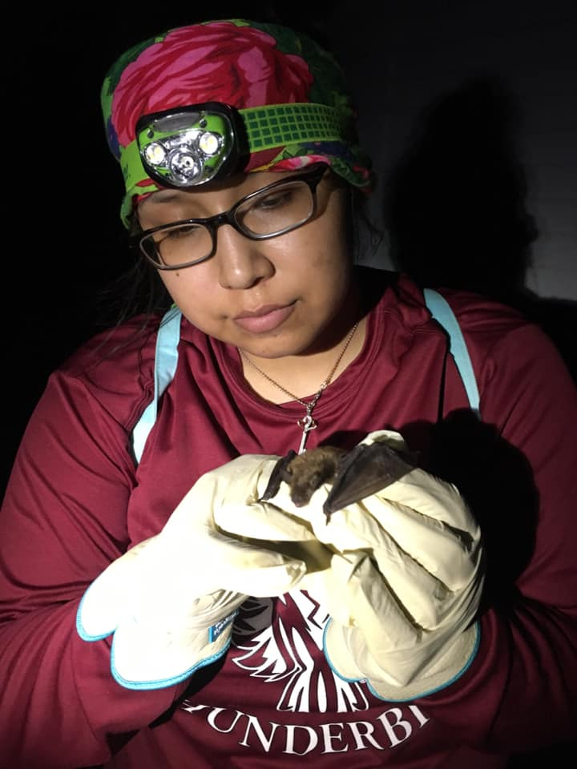
Batwomen and the Dark Night
Illuminating the Importance of Bats in North Dakota
Activity Overview:
Most people think about bats during Halloween, but bats are an important animal that we live with in North Dakota. UTTC faculty and environmental science students work together to find and study bats. In this activity you can:
Create your own model bat.
Use your bat to search for and learn about other things that we are connected to in our environment.
Listen to Robert Fox tell the story of “The Great Ball Game”
We recommend going through the activities in order but you can skip around as you like choosing which ones you would like to do.
Materials:
Paper and something to write with. Scissors (optional) Camera (optional)

Slide 2
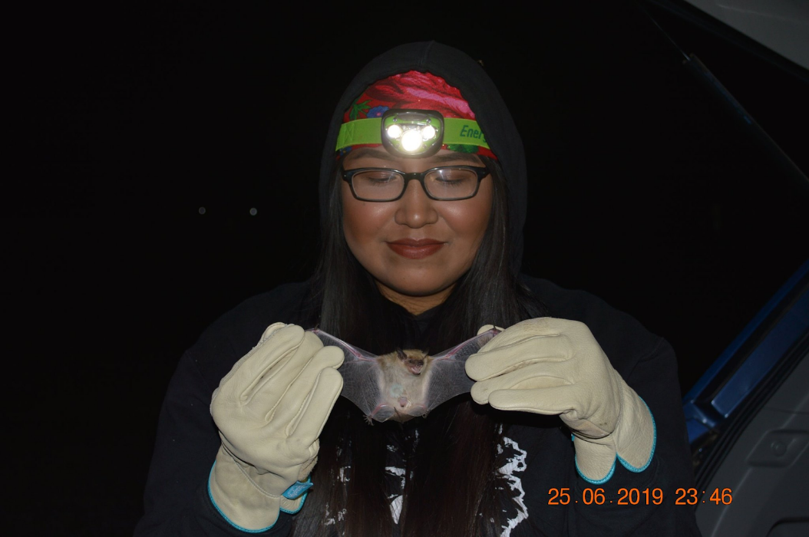
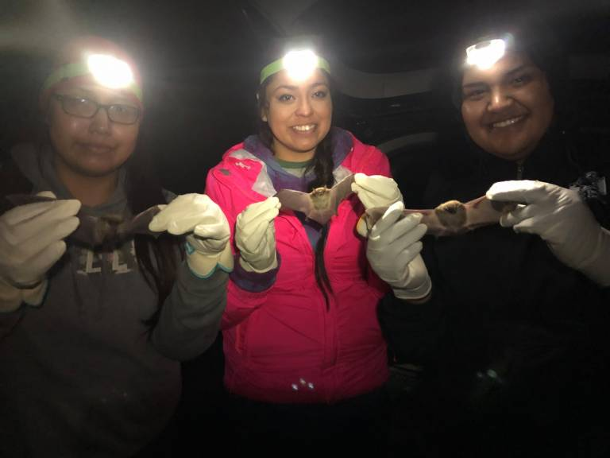
UTTC Student Spotlight: Amy Jackson (Navajo)
Amy is a 2019 graduate of United Tribes Technical College Environmental Science and Research Program. While a student At UTTC Amy conducted research on bats. She worked with many other students and faculty including Mandy Guinn (faculty), Kimberlee Blevins (pictured above right, MHA) Berlin West (pictured above far right, Cheyenne River).
Reflect:
Why do you think it is important for scientists to collaborate and work with other people? Brainstorm someone you can work with during this activity. Consider inviting another friend, an older or younger sibling, or a grandparent to participate with you!

Slide 3
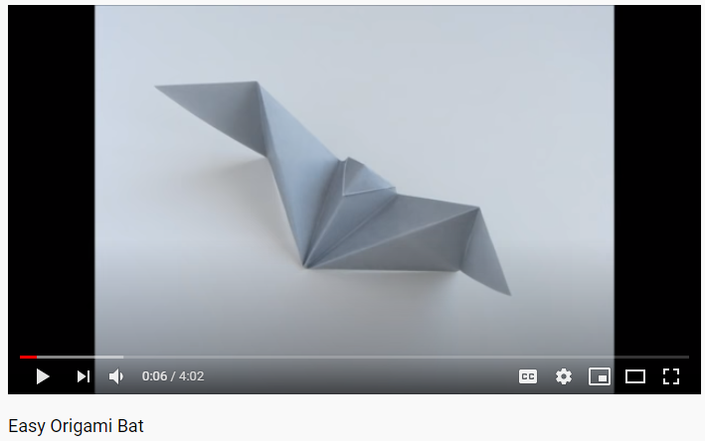
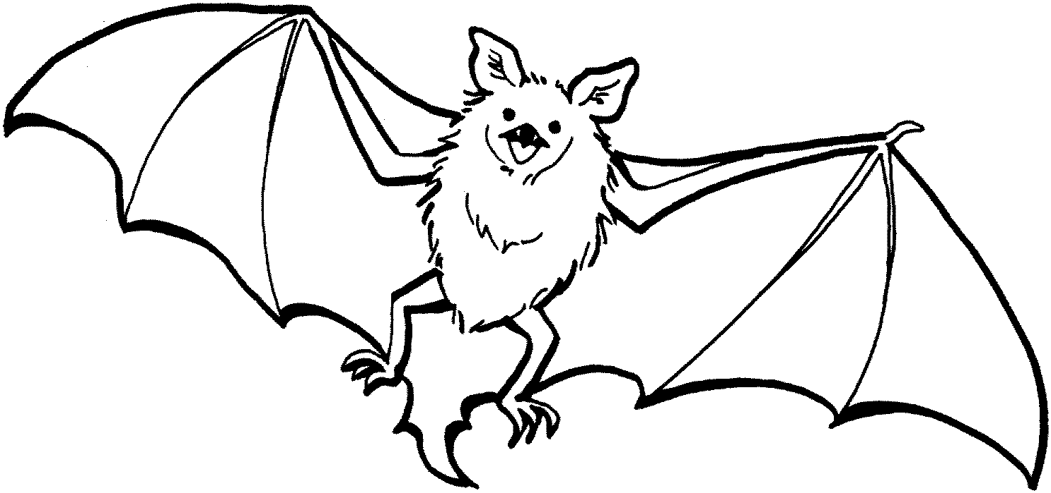
Part 1: Scientists use models to better understand the world around them. Start off by making a model of a bat. Choose what type of bat model you want to create:
Option 1 (best for upper elementary and older):
Make an Origami Bat by folding paper. Follow along on this YouTube tutorial:
https://www.youtube.com/watch?v=48fDg2Kcw9A
Option 2: (best for younger students):
Print, color, and cut out this bat:
Option 3: (good for all ages or those without a printer):
Draw your own bat using the picture above or pictures on the internet as a guide!

Slide 4
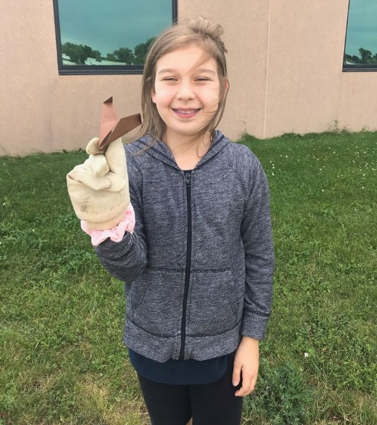
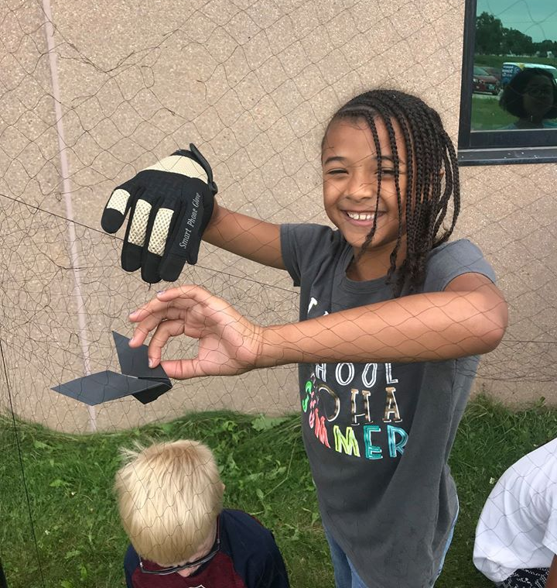
Part 2: We have relationships and share places with other animals, plants, water and other humans. I
Part 2: Imagine the model bat you created is a real bat and lives near you. Take your bat outside to look for ideas of places it might live or things it might eat. In the space below draw what types of relationships you think the bat has with others outside.
Share your drawing with the people you chose to work with.
How are your drawings different? What interesting things did they include?

Slide 5
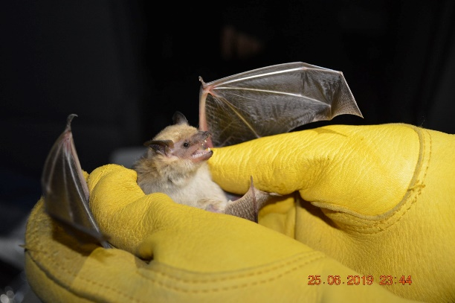
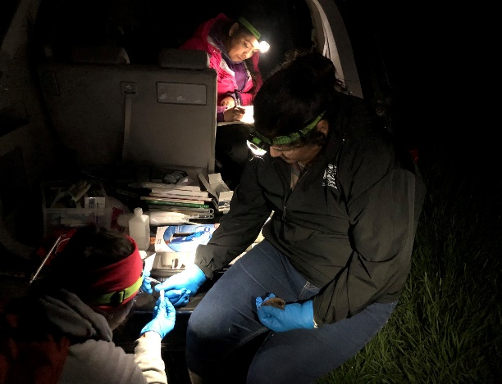
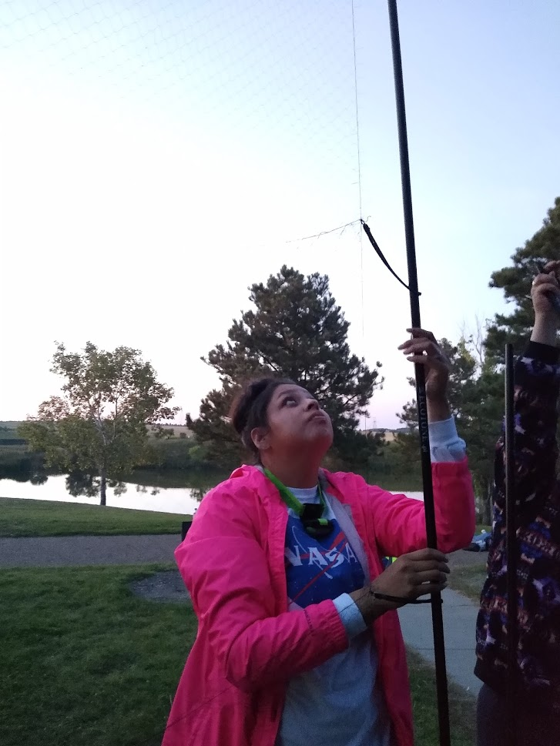
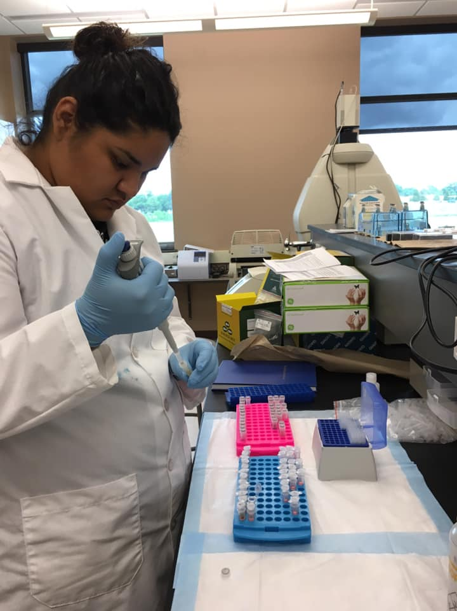
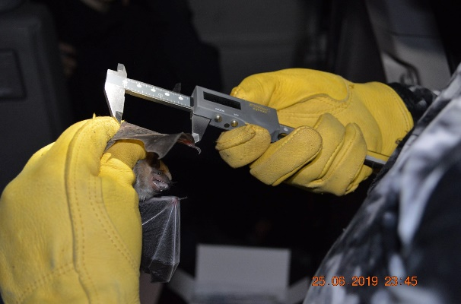
UTTC Student Spotlight: Amy Jackson (Navajo)
You went outside with your model bat, but UTTC students and scientists go outside to study real bats. Follow the path to see how they research bats in North Dakota. Talk through what you think is happening in each picture with a friend or family member.
Start Here
What questions came up as you looked at the pictures? We love talking about our research! Jot them in the comments of send us an email at abahnson@uttc.edu and we will try to answer your questions. Or, keep reading to learn about what UTTC has found while researching bats in North Dakota. You might find the answers to some of your questions.

Slide 6
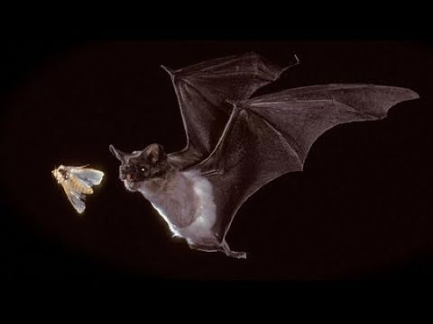
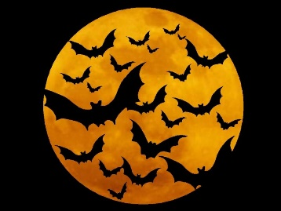
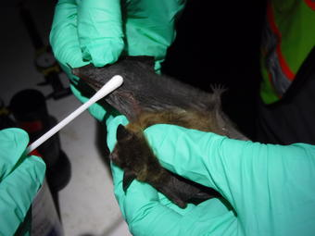
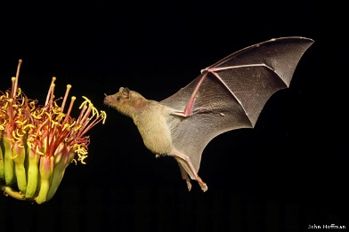
When you think about bats what comes to mind?
Follow the arrows to learn something that might change how you think about bats.
INSECTS
Most bats are insectivores-meaning they eat insects as their main source of food. During the night-they can eat half their weight by devouring mosquitos, moths, and beetles. Helping humans and PLANTS in the process!
At UTTC we study what they eat by examining molecular DNA evidence in their guano (aka poop).
HALLOWEEN
A lot of people have misinformation about bats and think bats are creepy or feed on blood but no ND bats feed on blood and 1,300 kinds of bats worldwide eat other things.
What do you think most bats eat?
Follow another arrow to find out
RESEARCH
The UTTC students and faculty study the ecology of Bats in North Dakota. Follow another arrow to learn about their research.
DISEASE
Bats can carry some human diseases but scientists are more concerned about diseases that can harm bats. White Nose Syndrome (WNS), is a fungus that is killing off bat populations. WNS was reported to have reached North Dakota in early August.
Why is this a concern? Follow an arrow to PLANTS or INSECTS to learn more.
PLANTS
Bats provide important assistance to plants by pollinating flowers to produce fruits and vegetables and by consuming INSECTS that may harm potato, corn, and soybean crops.
UTTC students are testing different techniques to monitor the benefits bats have on agriculture in ND.
How has your thinking changed about bats? Look back at your drawing you made in part two and add in something you learned in the reading or from the pictures that you might have left out. Consider going out on a second walk to look for things you might have missed. Take a picture with you and your bat and share it with us!

Slide 7
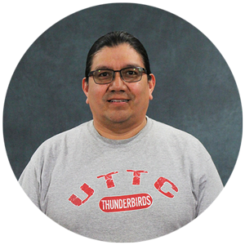
The Great Ball Game
Listen to Robert Fox tell the story of the bat and The Great Ball Game.
Why did the animals underestimate the bat?
What can we learn about interconnectedness and the importance of all living things from the story of The Great Ball Game?

Slide 8
How can you become a bat researcher?
United Tribes Technical College has many degree paths that can lead to a career in animal research. Visit the various websites to learn more about our programs and reach out to us to learn more!
Environmental Science
and Research
2 yr Associates and 4 yr Bachelors
Contact Information:
Mandy Guinn; mguinn@uttc.edu
https://uttc.edu/environmental-science-research/
Pre-Engineering
2 yr Associates
Contact Information:
Alexa Azure
aazure@uttc.edu
https://uttc.edu/pre-engineering/
Computer Information
Technology
2 yr Associates
Contact Information:
Dennis Lowman; dlowman@uttc.edu
https://uttc.edu/computer-information-technology/
Sustainable Agriculture
and Food Systems
2 yr Associates
Contact Information:
Brian McGinness; bmcginness@uttc.edu
https://uttc.edu/sustainable-agriculture-and-food-systems/

