Slide 1
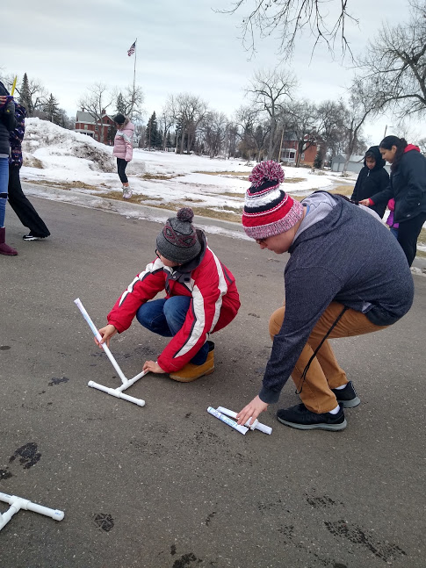
3… 2… 1…TAKEOFF!
Activity Overview:
In this activity guide learn all about aerospace engineering-the type of engineering that designs and builds machines for flight. You can use the guide in order or choose from any of the learning activities below:
Meet Marlin Chase (MHA), a UTTC Pre-Engineering Student, in the student spotlight | Design and test paper airplanes
Head outside on a walk to observe birds in flight | Watch live as Americans launch into space
Materials:
Paper Optional: scissors, tape, tape measurer, timer/stopwatch

Slide 2
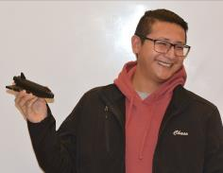
UTTC Student Spotlight: Marlin Chase (MHA)
Marlin Chase (MHA) is a pre-engineering student at UTTC with an interest in aerospace engineering. He is also a member of the UTTC First Nations Launch Rocket Team. Learn more about the First Nations Launch program by watching the video linked in the comments.
Reflect:
Engineers often work in teams to complete a project. If you were to design a rocket to go to space who are some people you would recruit to be on your team? Why did you choose those people? What strengths would they bring to your team? Consider inviting them to design and test paper airplanes with you.
Try being an aerospace engineer with this challenge!
Notes:
https://www.youtube.com/watch?v=KTqaSFP5exc&feature=youtu.be

Slide 3
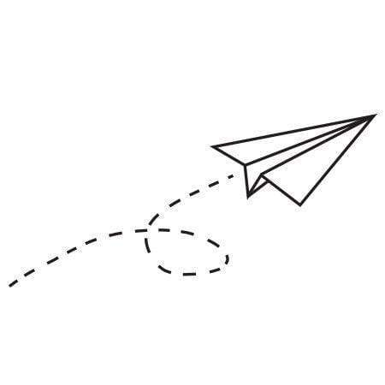
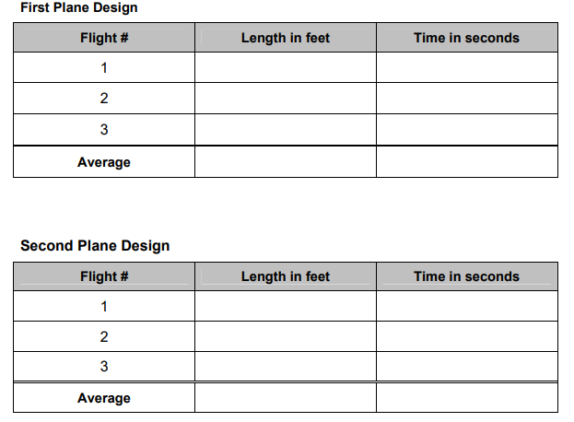
Try out aerospace engineering with this challenge!
Design and build two different paper airplanes.
Looking for ideas? Try out one of the designs linked in the comments.
Fly your airplanes three times each, and record the distance of each flight to the nearest foot as well as the amount of time it stayed in the air. Consider organizing your data in a table like the one pictured here.
No stopwatch or tape measurer? Just mark with a stone or stick where your plane lands each time.
Which paper airplane had the best performance?
How might you change your design to make your plane better?
Try adding a “passenger” by taping a small rock to your plane. How does that change how far and long your plane can fly?
Share your creations with us in the comments! Or tag your photos with #UTTCSTEM or @unitedtribestech
Notes:
https://www.teachengineering.org/content/cub_/activities/cub_airplanes/cub_airplanes_lesson06_activity1_sample.pdf

Slide 4
Search for aerospace in nature
Observing birds can provide inspiration and knowledge about flight. Head out on a walk to see if you can spot different birds flying. To focus your observations try paying special attention to the bird at different points throughout it’s flight.
Take off:
How does the bird prepare to take off? What do you notice about their wings or legs in this stage?
In air:
What does the bird do with it’s wings once in the air?
Are their wings flat or curved?
How do they move their wings to change speed or direction?
Landing:
How does the bird move it’s wings as it lands?
What do birds that land in water do differently than birds that land in trees or
on the ground?

Slide 5
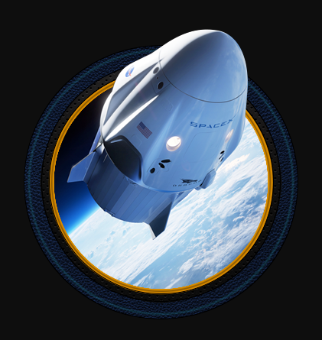
UTTC Student Spotlight: Amy Jackson (Navajo)
Watch a launch live on NASA TV
For the first time since 2011, NASA is sending American astronauts back to space, on an American rocket, from American soil and they want YOU to join them for launch!
The Launch is scheduled for 4:33 p.m. EDT on Wednesday, May 27.
Find out how you can watch and participate by following the link in the comments!
Notes:
https://www.nasa.gov/specials/virtual-guest/index.html

Slide 6
How can you become an aerospace engineer?
United Tribes Technical College has many degree paths that can lead to a career in engineering. Visit the various websites to learn more about our programs and reach out to us to learn more!
Environmental Science
and Research
2 yr Associates and 4 yr Bachelors
Contact Information:
Mandy Guinn; mguinn@uttc.edu
https://uttc.edu/environmental-science-research/
Pre-Engineering
2 yr Associates
Contact Information:
Alexa Azure
aazure@uttc.edu
https://uttc.edu/pre-engineering/
Computer Information
Technology
2 yr Associates
Contact Information:
Dennis Lowman; dlowman@uttc.edu
https://uttc.edu/computer-information-technology/
Sustainable Agriculture
and Food Systems
2 yr Associates
Contact Information:
Brian McGinness; bmcginness@uttc.edu
https://uttc.edu/sustainable-agriculture-and-food-systems/

