Slide 1
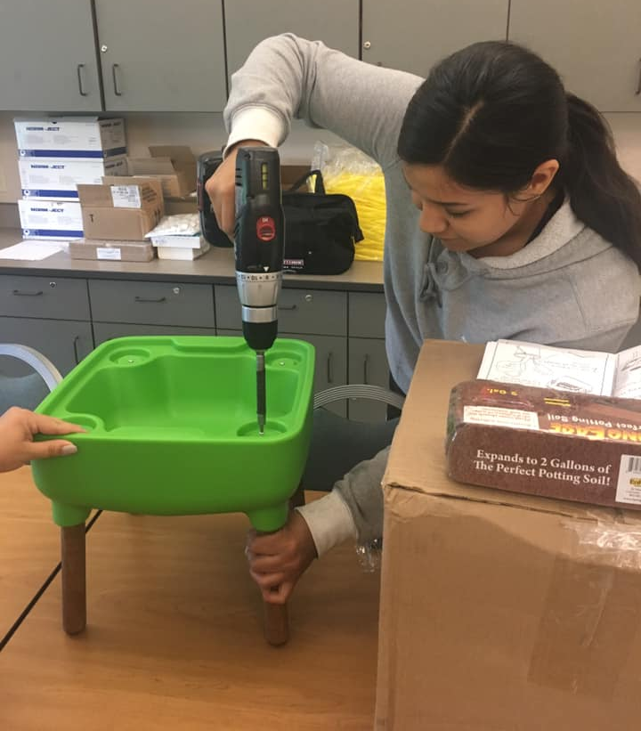
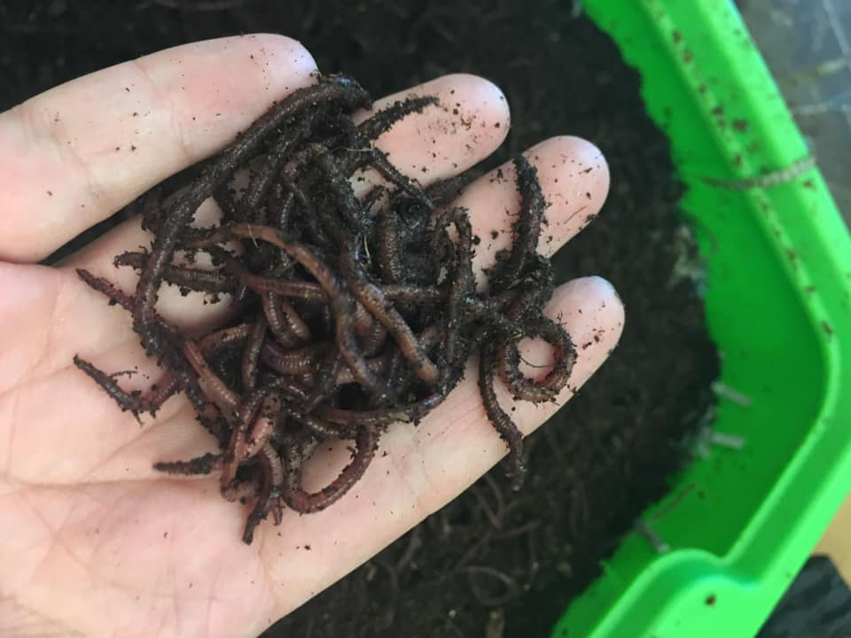
Black Gold
Investigating compost to enrich our soils
Activity Overview:
In this activity guide investigate composting: a process that recycles nutrients in the soil so our plants can grow. You can use the guide in order or choose from any of the learning activities below:
Meet K’Lona Lofton (Cheyenne River) in the student spotlight | Create and investigate a compost column
Head outside to search for composting critters | Make an edible compost snack
Materials:
Empty Plastic water or pop bottles Various materials found in nature Pudding Oreos Gummy Worms

Slide 2
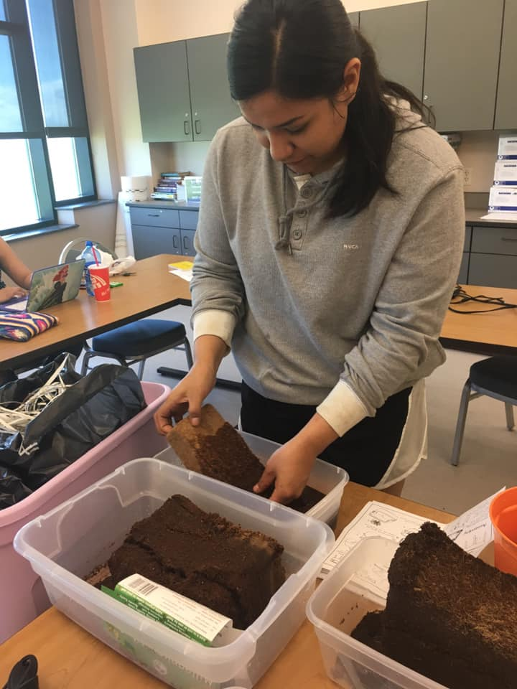
UTTC Student Spotlight: K’Lona Lofton (Cheyenne River)
K’Lona Lofton (Cheyenne River) graduated in 2020 with her Associate’s degree in Environmental Science and Research. Her research project looked at the influence of diet on the nutrient levels found in the vermicompost casts (aka worm poop) of red-wiggler worms.
K’Lona says “My early goals I have with this career is to become an environmental consultant on my reservation to help my community become eco-friendly! I want to educate the youth about using everything Mother earth has to offer and teach them about the importance of sustainability at a young age.”
Reflect:
K’Lona’s research is inspired by her desire to help her community care for the earth. What is something in your community that you care for and would like to study? Draw out your ideas and share them with a friend or family member or share with us in the comments!

Slide 3
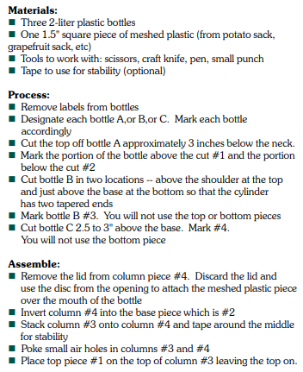
Investigate compost like K’Lona did using your own compost column!
Build your column:
Add the four basic compost ingredients to your column:
Browns (nitrogen):
Choose from: Small dried leaves, small sticks, cut up cardboard, newspaper, pine needles, old potting soil
Greens (carbon):
Choose from: Small green leaves, grass clippings, fruit and vegetable scraps, coffee grinds, teabags, wilted flowers
Moisture (water):
Add enough so it is moist but not wet.
Oxygen (air) :
Remember to make sure you have poked some small air holes in columns three and four.
Investigate what happens over time:
How often will you observe your column?
What measurements do you plan to take?
Temperature?
Visual descriptions?
Height of materials inside the column?
An important piece of science is sharing what you discover.
How will you share your observations?
A poster presentation like K’lona did?
A video?
An art piece?
Notes:
https://hgsubsidence.org/wp-content/uploads/2013/05/Bottle-Biology-Learn-how-to-create-a-compost-column.pdf

Slide 4
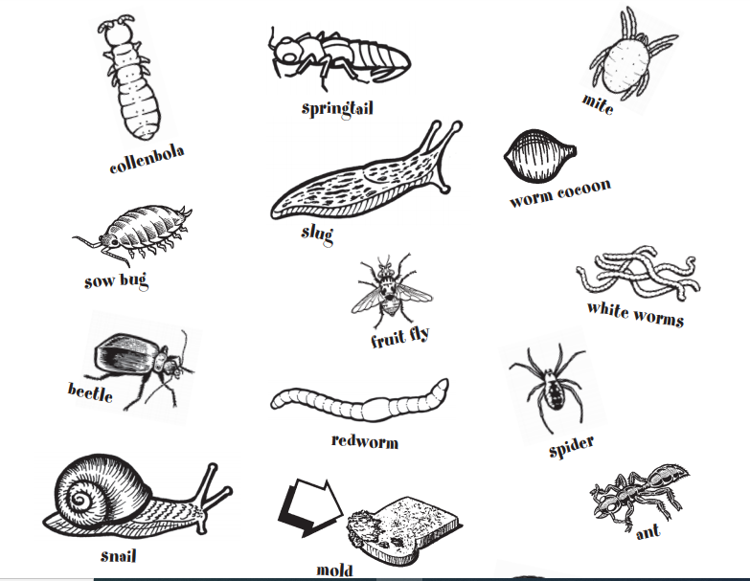
Search for compost critters in nature
How many of these can you find outside?
Try searching in many different places:
under logs
under benches
under a pile of leaves
in the soil
What location did you find the most compost critters in?
Document your observations with a camera and share with us what you find!
If you didn’t find many, why do you think that is the case?
What time of day did you search?
What was the weather like? Was it hot outside, cold, wet, or dry?
Notes:
This activity is modified from: http://www.cvswmd.org/uploads/6/1/2/6/6126179/do_the_rot_thing_cvswmd1.pdf Head to the resource for many more composting ideas.

Slide 5
Make an edible compost snack
Try making this simple 3 ingredient snack to model worm composting!
The real version from K’Lona’s research
(don’t eat these)
The edible version!
Assemble and eat:
Chocolate pudding, crushed Oreos, gummy worms!
Do you have another idea for a compost snack? Share your recipe in the comments!

Slide 6
How can you become an environmental scientist?
United Tribes Technical College has many degree paths that can lead to a career in environmental science. Visit the various websites to learn more about our programs and reach out to us to learn more!
Environmental Science
and Research
2 yr Associates and 4 yr Bachelors
Contact Information:
Mandy Guinn; mguinn@uttc.edu
https://uttc.edu/environmental-science-research/
Pre-Engineering
2 yr Associates
Contact Information:
Alexa Azure
aazure@uttc.edu
https://uttc.edu/pre-engineering/
Computer Information
Technology
2 yr Associates
Contact Information:
Dennis Lowman; dlowman@uttc.edu
https://uttc.edu/computer-information-technology/
Sustainable Agriculture
and Food Systems
2 yr Associates
Contact Information:
Brian McGinness; bmcginness@uttc.edu
https://uttc.edu/sustainable-agriculture-and-food-systems/

