Slide 1
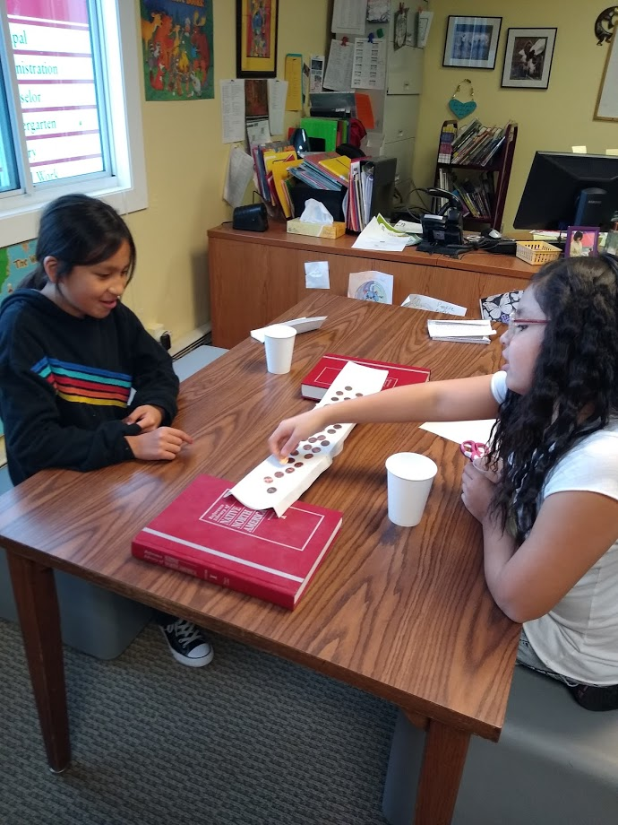
Innovative Structures
Using models to engineer solutions
Activity Overview:
There are over 200 kinds of engineers! In this activity guide learn all about civil and architectural engineering-the type of engineering that designs and tests buildings and other important structures like bridges. You can use the guide in order or choose from any of the learning activities below:
Meet Taylor Brugh, a UTTC Pre-Engineering Student, in the Student Spotlight | Read an Anishinaabe story about Nanabush and the Bridge
Try to build the strongest model bridge using only one piece of paper | Head outside on a walk to look for strong and stable structures
Materials:
Paper Something to test the strength of your bridge (Pennies, rocks, or goldfish)

Slide 2
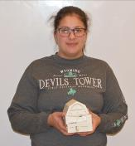
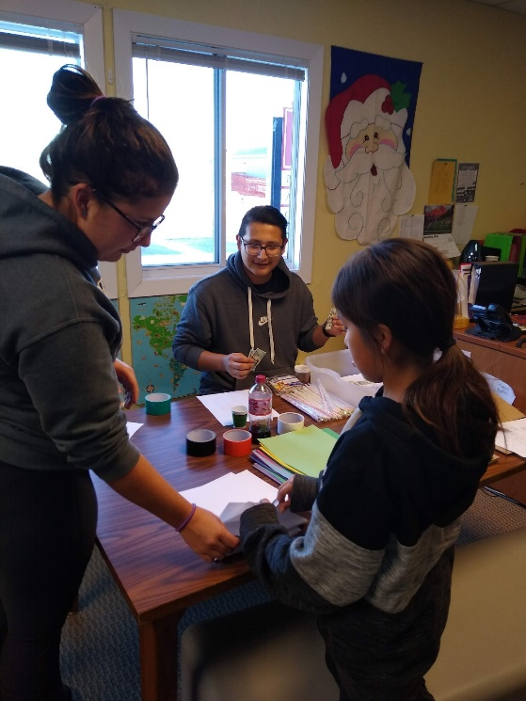
UTTC Student Spotlight: Taylor Brugh (MHA)
Taylor Brugh (MHA) is a pre-engineering student at United Tribes Technical College. Taylor hopes to become a civil or architectural engineer and one day design new buildings for her community. Pictured to the right she is holding a 3D printed model of a house and helping an elementary student design a model house.
Reflect:
Engineers often use models before creating their real product. Why do you think engineers use do this? Share with a friend or family member why you think Taylor printed a 3D house before building a real house.
Keep reading to learn how you can use a model to help Nanabush build a bridge.

Slide 3
NANABUSH AND THE BRIDGE
as told by Anishinaabe storyteller Eileen Conroy
Nanabush woke early. The birds were singing a spring song and it was going to be a good day to catch some fish for Nokomis. He carefully prepared his pack for his work - fish net, spear, paddle, a small bag of dried moosemeat for a snack and a little cone of maple sugar.
He paddled his bark canoe out onto the Great Lake and around the point into the cove where the fish liked to spend their time, just near the mouth of the river. Nanabush put out his net and headed for the shore. He fished at the rapids with his spear and caught several nice fat walleye for a shore lunch. At the end of the day Nanabush pulled up his nets and filled the canoe with fresh fish. He paddled home and unloaded the canoe. The pack was soon filled with fish for Nokomis. Nanabush smiled as he started up the path to Nokomis’ wigwam.
He had not gone far when he came to the place where the path crossed a creek. Usually there was an old cedar tree that had fallen across the creek- it made the perfect bridge. Nanabush could cross the bridge with his eyes closed! But today something was terribly wrong….
Where was the cedar tree? There was no bridge across the creek- the spring thaw and the rains had filled the creek with flood water. The force of the water had picked up the old cedar tree and carried it far downstream while Nanabush was fishing. It was impossible for him to cross the creek now because the water was too deep and he could not carry the heavy pack while trying to balance in the cold spring flood water.
What was Nanabush to do??? He thought and thought and used his imagination – he would need to build a new bridge… but how? He only had his pack and the fish and the fish net with him. Nanabush looked along the banks of the creek, searching for another cedar tree but there were none that had fallen down. At last he saw an old birch log laying back in the bush- the wood from the tree had long ago rotted and was becoming soil – but the wiigwas (birch bark) was still intact. Maybe he could use the birch bark to make a new bridge. Nanabush carefully picked up the large sheet of bark and carried it to the bank of the creek. He sat down to plan how he might turn the piece of bark into a bridge.
Reflect and Share: Have you ever had a time when things didn’t go as you hoped and planned? Did you have to figure out how to get yourself out of a problem situation? How do you think Nanabush solved his problem?

Slide 4
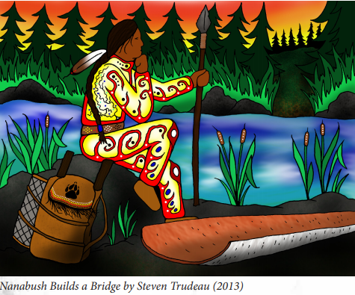
Part 2: We have relationships and share places with other animals, plants, water and other humans. I
Can you help Nanabush make a bridge that will carry him and his pack full of food across from one side of the creek to the other?
Problem: Nanabush only has one piece of birch bark and needs to cross the river.
Challenge: Using only one piece of paper (to represent Nanabush’s birch bark) design a bridge that will span a gap of about 6 inch and be able to support weight.
Draw a model: Start by drawing a picture of your idea. What might you do to your one piece of paper to make it stronger? How might you fold or roll the paper?
Build and test your bridge: Using pennies, rocks, or goldfish snacks see how much weight your bridge can hold.
Redesign: Try changing your design to see if you can make it stronger!
Share your creations with us in the comments! Or tag your photos with #UTTCSTEM or @unitedtribestech

Slide 5
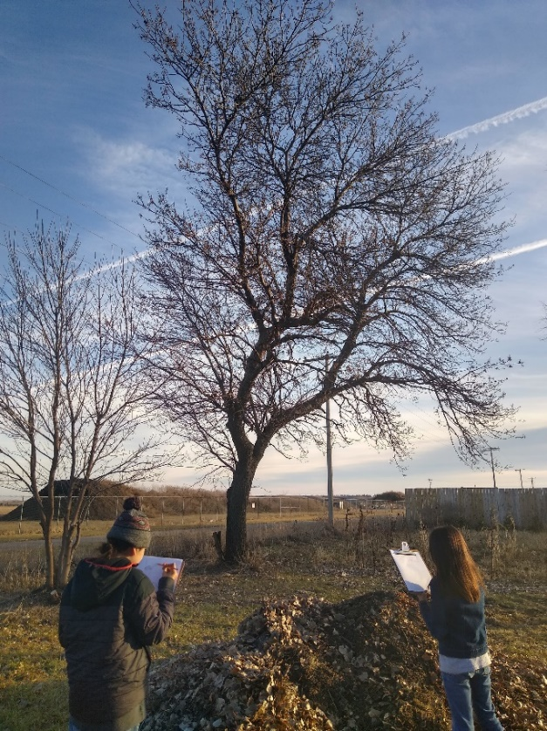
UTTC Student Spotlight: Amy Jackson (Navajo)
Search for structures all around us
People build lots of different things. Other animals do as well. We build things to help make our lives and work less difficult.
Take a walk outside to search for many different examples of structures. Bring a notebook to record through pictures, drawings, and words the structures that you find.
Invite a friend or family member on your walk and make note of what you find together!
What structures did you find that were human made?
What structures did you find that other animals made?
What features of the structure do you think help make it strong and stable?
When back inside, try using materials found around your home to build a model structure of something you noticed outside.
Theodore Jamerson Elementary students found a nest while searching for structures. Tag your structures with #UTTCSTEM
The activities used in this guide were adapted from curriculum developed by Aboriginal Access to Engineering at Queen’s University in Canada. Queen’s University is committed to increasing the number of indigenous engineers by creating culturally relevant educational materials for Indigenous youth and their teachers. You can learn more about their work here.

Slide 6
How can you become a civil engineer?
United Tribes Technical College has many degree paths that can lead to a career in engineering. Visit the various websites to learn more about our programs and reach out to us to learn more!
Environmental Science
and Research
2 yr Associates and 4 yr Bachelors
Contact Information:
Mandy Guinn; mguinn@uttc.edu
https://uttc.edu/environmental-science-research/
Pre-Engineering
2 yr Associates
Contact Information:
Alexa Azure
aazure@uttc.edu
https://uttc.edu/pre-engineering/
Computer Information
Technology
2 yr Associates
Contact Information:
Dennis Lowman; dlowman@uttc.edu
https://uttc.edu/computer-information-technology/
Sustainable Agriculture
and Food Systems
2 yr Associates
Contact Information:
Brian McGinness; bmcginness@uttc.edu
https://uttc.edu/sustainable-agriculture-and-food-systems/

